Slide 1
Data Quality and Data Cleaning: An Overview
Theodore Johnson
johnsont@research.att.com
AT&T Labs – Research
(Lecture notes for CS541, 02/12/2004)
Notes:
Parni is a statistician, will give a similar tutorial at JSM.
Focus on data mining and analysis as well as operations.
Some changes in slides from handouts

Slide 2
Based on:
Recent book
Exploratory Data Mining and Data Quality
Dasu and Johnson
(Wiley, 2004)
SIGMOD 2003 tutorial.
Notes:
This is 2 hour summary of our new book.
We drew on our experiences, and also those of many other people
At at&t labs – research who engage in data intensive projects.

Slide 3
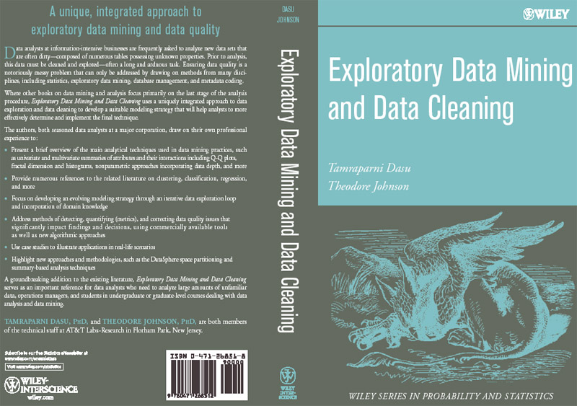

Slide 4
Tutorial Focus
What research is relevant to Data Quality?
  DQ is pervasive and expensive. It is an important problem.
  But the problems are so messy and unstructured that research seems irrelevant.
This tutorial will try to structure the problem to make research directions more clear.
Overview
  Data quality process
    Where do problems come from
    How can they be resolved
  Disciplines
    Management
    Statistics
    Database
    Metadata
Notes:
Focus on research, but also a lot of practice.

Slide 5
Overview
The meaning of data quality (1)
The data quality continuum
The meaning of data quality (2)
Data quality metrics
Technical tools
  Management
  Statistical
  Database
  Metadata
Case Study
Research directions

Slide 6
The Meaning of Data Quality (1)

Slide 7
Meaning of Data Quality (1)
Generally, you have a problem if the data doesn’t mean what you think it does, or should
  Data not up to spec : garbage in, glitches, etc.
  You don’t understand the spec : complexity, lack of metadata.
Many sources and manifestations
  As we will see.
Data quality problems are expensive and pervasive
  DQ problems cost hundreds of billion $$$ each year.
  Resolving data quality problems is often the biggest effort in a data mining study.
Notes:
Many sources and manifestations make definitions difficult.
But it is necessary to get a grip on the problem because … expensive and pervasive.

Slide 8
Example
T.Das|97336o8327|24.95|Y|-|0.0|1000
Ted J.|973-360-8779|2000|N|M|NY|1000
Can we interpret the data?
  What do the fields mean?
  What is the key? The measures?
Data glitches
  Typos, multiple formats, missing / default values
Metadata and domain expertise
  Field three is Revenue. In dollars or cents?
  Field seven is Usage. Is it censored?
    Field 4 is a censored flag. How to handle censored data?

Slide 9
Data Glitches
Systemic changes to data which are external to the recorded process.
  Changes in data layout / data types
    Integer becomes string, fields swap positions, etc.
  Changes in scale / format
    Dollars vs. euros
  Temporary reversion to defaults
    Failure of a processing step
  Missing and default values
    Application programs do not handle NULL values well …
  Gaps in time series
    Especially when records represent incremental changes.

Slide 10
Conventional Definition of Data Quality
Accuracy
  The data was recorded correctly.
Completeness
  All relevant data was recorded.
Uniqueness
  Entities are recorded once.
Timeliness
  The data is kept up to date.
    Special problems in federated data: time consistency.
Consistency
  The data agrees with itself.

Slide 11
Problems …
Unmeasurable
  Accuracy and completeness are extremely difficult, perhaps impossible to measure.
Context independent
  No accounting for what is important. E.g., if you are computing aggregates, you can tolerate a lot of inaccuracy.
Incomplete
  What about interpretability, accessibility, metadata, analysis, etc.
Vague
  The conventional definitions provide no guidance towards practical improvements of the data.

Slide 12
Finding a modern definition
We need a definition of data quality which
  Reflects the use of the data
  Leads to improvements in processes
  Is measurable (we can define metrics)
First, we need a better understanding of how and where data quality problems occur
  The data quality continuum

Slide 13
The Data Quality Continuum

Slide 14
The Data Quality Continuum
Data and information is not static, it flows in a data collection and usage process
  Data gathering
  Data delivery
  Data storage
  Data integration
  Data retrieval
  Data mining/analysis

Slide 15
Data Gathering
How does the data enter the system?
Sources of problems:
  Manual entry
  No uniform standards for content and formats
  Parallel data entry (duplicates)
  Approximations, surrogates – SW/HW constraints
  Measurement errors.
Notes:
MPDS workshop, John Bates

Slide 16
Solutions
Potential Solutions:
  Preemptive:
    Process architecture (build in integrity checks)
    Process management (reward accurate data entry, data sharing, data stewards)
  Retrospective:
    Cleaning focus (duplicate removal, merge/purge, name & address matching, field value standardization)
    Diagnostic focus (automated detection of glitches).

Slide 17
Data Delivery
Destroying or mutilating information by inappropriate pre-processing
  Inappropriate aggregation
  Nulls converted to default values
Loss of data:
  Buffer overflows
  Transmission problems
  No checks

Slide 18
Solutions
Build reliable transmission protocols
  Use a relay server
Verification
  Checksums, verification parser
  Do the uploaded files fit an expected pattern?
Relationships
  Are there dependencies between data streams and processing steps
Interface agreements
  Data quality commitment from the data stream supplier.

Slide 19
Data Storage
You get a data set. What do you do with it?
Problems in physical storage
  Can be an issue, but terabytes are cheap.
Problems in logical storage (ER → relations)
  Poor metadata.
    Data feeds are often derived from application programs or legacy data sources. What does it mean?
  Inappropriate data models.
    Missing timestamps, incorrect normalization, etc.
  Ad-hoc modifications.
    Structure the data to fit the GUI.
  Hardware / software constraints.
    Data transmission via Excel spreadsheets, Y2K

Slide 20
Solutions
Metadata
  Document and publish data specifications.
Planning
  Assume that everything bad will happen.
  Can be very difficult.
Data exploration
  Use data browsing and data mining tools to examine the data.
    Does it meet the specifications you assumed?
    Has something changed?

Slide 21
Data Integration
Combine data sets (acquisitions, across departments).
Common source of problems
  Heterogenous data : no common key, different field formats
    Approximate matching
  Different definitions
    What is a customer: an account, an individual, a family, …
  Time synchronization
    Does the data relate to the same time periods? Are the time windows compatible?
  Legacy data
    IMS, spreadsheets, ad-hoc structures
  Sociological factors
    Reluctance to share – loss of power.

Slide 22
Solutions
Commercial Tools
  Significant body of research in data integration
  Many tools for address matching, schema mapping are available.
Data browsing and exploration
  Many hidden problems and meanings : must extract metadata.
  View before and after results : did the integration go the way you thought?

Slide 23
Data Retrieval
Exported data sets are often a view of the actual data. Problems occur because:
  Source data not properly understood.
  Need for derived data not understood.
  Just plain mistakes.
    Inner join vs. outer join
    Understanding NULL values
Computational constraints
  E.g., too expensive to give a full history, we’ll supply a snapshot.
Incompatibility
  Ebcdic?

Slide 24
Data Mining and Analysis
What are you doing with all this data anyway?
Problems in the analysis.
  Scale and performance
  Confidence bounds?
  Black boxes and dart boards
    “fire your Statisticians”
  Attachment to models
  Insufficient domain expertise
  Casual empiricism
Notes:
Casual empiricism : use an arbitrary number to support a pre-conception.

Slide 25
Solutions
Data exploration
  Determine which models and techniques are appropriate, find data bugs, develop domain expertise.
Continuous analysis
  Are the results stable? How do they change?
Accountability
  Make the analysis part of the feedback loop.

Slide 26
The Meaning of Data Quality (2)

Slide 27
Meaning of Data Quality (2)
There are many types of data, which have different uses and typical quality problems
  Federated data
  High dimensional data
  Descriptive data
  Longitudinal data
  Streaming data
  Web (scraped) data
  Numeric vs. categorical vs. text data

Slide 28
Meaning of Data Quality (2)
There are many uses of data
  Operations
  Aggregate analysis
  Customer relations …
Data Interpretation : the data is useless if we don’t know all of the rules behind the data.
Data Suitability : Can you get the answer from the available data
  Use of proxy data
  Relevant data is missing
Notes:
Challenge in operations : many handoffs. Some processes more important than others.
Challenge in aggregate analysis: can tolerate errors, but you’re summing up over a lot of data, therefore likely to add in glitched data.
Customer relations : the fields must be accurate, but errors don’t spread.

Slide 29
Data Quality Constraints
Many data quality problems can be captured by static constraints based on the schema.
  Nulls not allowed, field domains, foreign key constraints, etc.
Many others are due to problems in workflow, and can be captured by dynamic constraints
  E.g., orders above $200 are processed by Biller 2
The constraints follow an 80-20 rule
  A few constraints capture most cases, thousands of constraints to capture the last few cases.
Constraints are measurable. Data Quality Metrics?
Notes:
Dynamic constraints often come from operational databases. But analysis data sets, CRM databases are often derived from operational data.

Slide 30
Data Quality Metrics

Slide 31
Data Quality Metrics
We want a measurable quantity
  Indicates what is wrong and how to improve
  Realize that DQ is a messy problem, no set of numbers will be perfect
Types of metrics
  Static vs. dynamic constraints
  Operational vs. diagnostic
Metrics should be directionally correct with an improvement in use of the data.
A very large number metrics are possible
  Choose the most important ones.
Notes:
Metrics can give incentives for bad behavior : throw away data that doesn’t join.

Slide 32
Examples of Data Quality Metrics
Conformance to schema
  Evaluate constraints on a snapshot.
Conformance to business rules
  Evaluate constraints on changes in the database.
Accuracy
  Perform inventory (expensive), or use proxy (track complaints). Audit samples?
Accessibility
Interpretability
Glitches in analysis
Successful completion of end-to-end process

Slide 33
Data Quality Process
Data Gathering
Data Loading (ETL)
Data Scrub – data profiling, validate data constraints
Data Integration – functional dependencies
Develop Biz Rules and Metrics
– interact with domain experts
Validate biz rules
Stabilize Biz Rules
Verify Biz Rules
Recommendations
Quantify Results
Summarize Learning
Data Quality Check

Slide 34
Technical Tools

Slide 35
Technical Approaches
We need a multi-disciplinary approach to attack data quality problems
  No one approach solves all problem
Process management
  Ensure proper procedures
Statistics
  Focus on analysis: find and repair anomalies in data.
Database
  Focus on relationships: ensure consistency.
Metadata / domain expertise
  What does it mean? Interpretation

Slide 36
Process Management
Business processes which encourage data quality.
  Assign dollars to quality problems
  Standardization of content and formats
  Enter data once, enter it correctly (incentives for sales, customer care)
  Automation
  Assign responsibility : data stewards
  End-to-end data audits and reviews
    Transitions between organizations.
  Data Monitoring
  Data Publishing
  Feedback loops

Slide 37
Feedback Loops
Data processing systems are often thought of as open-loop systems.
  Do your processing then throw the results over the fence.
  Computers don’t make mistakes, do they?
Analogy to control systems : feedback loops.
  Monitor the system to detect difference between actual and intended
  Feedback loop to correct the behavior of earlier components
  Of course, data processing systems are much more complicated than linear control systems.
Notes:
Easier and faster to build open-loop. Closed loop requires coordination and therefore administration hassles.

Slide 38
Example
Sales, provisioning, and billing for telecommunications service
  Many stages involving handoffs between organizations and databases
  Simplified picture
Transition between organizational boundaries is a common cause of problems.
Natural feedback loops
  Customer complains if the bill is to high
Missing feedback loops
  No complaints if we undercharge.
Notes:
Feedback loops one of the most important management tools. Encourage some data redundancy?
Another example : dblp

Slide 39
Example
Customer
Sales Order
Customer
Care
Customer Account
Information
Billing
Provisioning
Existing Data Flow
Missing Data Flow

Slide 40
Monitoring
Use data monitoring to add missing feedback loops.
Methods:
  Data tracking / auditing
    Follow a sample of transactions through the workflow.
    Build secondary processing system to detect possible problems.
  Reconciliation of incrementally updated databases with original sources.
  Mandated consistency with a Database of Record (DBOR).
  Feedback loop sync-up
  Data Publishing
Notes:
Monitoring : database redundancy.
Feedback loop syncup : e.g. the blue lines added in the previous slide.

Slide 41
Data Publishing
Make the contents of a database available in a readily accessible and digestible way
  Web interface (universal client).
  Data Squashing : Publish aggregates, cubes, samples, parametric representations.
  Publish the metadata.
Close feedback loops by getting a lot of people to look at the data.
Surprisingly difficult sometimes.
  Organizational boundaries, loss of control interpreted as loss of power, desire to hide problems.

Slide 42
Statistical Approaches
No explicit DQ methods
  Traditional statistical data collected from carefully designed experiments, often tied to analysis
  But, there are methods for finding anomalies and repairing data.
  Existing methods can be adapted for DQ purposes.
Four broad categories can be adapted for DQ
  Missing, incomplete, ambiguous or damaged data e.g truncated, censored
  Suspicious or abnormal data e.g. outliers
  Testing for departure from models
  Goodness-of-fit

Slide 43
Missing Data
Missing data - values, attributes, entire records, entire sections
Missing values and defaults are indistinguishable
Truncation/censoring - not aware, mechanisms not known
Problem: Misleading results, bias.

Slide 44
Detecting Missing Data
Overtly missing data
  Match data specifications against data - are all the attributes present?
  Scan individual records - are there gaps?
  Rough checks : number of files, file sizes, number of records, number of duplicates
  Compare estimates (averages, frequencies, medians) with “expected” values and bounds; check at various levels of granularity since aggregates can be misleading.
Notes:
Sanity checks that a statistician usually performs, often by hand.

Slide 45
Missing data detection (cont.)
Hidden damage to data
  Values are truncated or censored - check for spikes and dips in distributions and histograms
  Missing values and defaults are indistinguishable - too many missing values? metadata or domain expertise can help
  Errors of omission e.g. all calls from a particular area are missing - check if data are missing randomly or are localized in some way
Notes:
Dq mining : use “missing data” as a predicate, then do OLAP browsing, decision tree, etc.

Slide 46
Imputing Values to Missing Data
In federated data, between 30%-70% of the data points will have at least one missing attribute - data wastage if we ignore all records with a missing value
Remaining data is seriously biased
Lack of confidence in results
Understanding pattern of missing data unearths data integrity issues
Notes:
If you are building a model, can’t use a record if an important attribute is missing.
But fields might not be missing at random (actually probably not : income vs. missing telephone number).

Slide 47
Missing Value Imputation - 1
Standalone imputation
  Mean, median, other point estimates
  Assume: Distribution of the missing values is the same as the non-missing values.
  Does not take into account inter-relationships
  Introduces bias
  Convenient, easy to implement
Notes:
Missing at random.

Slide 48
Missing Value Imputation - 2
Better imputation - use attribute relationships
Assume : all prior attributes are populated
  That is, monotonicity in missing values.
  X1| X2| X3| X4| X5
  1.0| 20| 3.5| 4| .
  1.1| 18| 4.0| 2| .
  1.9| 22| 2.2| .| .
  0.9| 15| .| .| .
Two techniques
  Regression (parametric),
  Propensity score (nonparametric)

Slide 49
Missing Value Imputation –3
Regression method
  Use linear regression, sweep left-to-right
  X3=a+b*X2+c*X1;
  X4=d+e*X3+f*X2+g*X1, and so on
  X3 in the second equation is estimated from the first equation if it is missing

Slide 50
Missing Value Imputation - 3
Propensity Scores (nonparametric)
  Let Y_{j}=1 if X_{j} is missing, 0 otherwise
  Estimate P(Y_{j} =1) based on X₁ through X_{(j-1)} using logistic regression
  Group by propensity score P(Y_{j} =1)
  Within each group, estimate missing X_{j}s from known X_{j}s using approximate Bayesian bootstrap.
  Repeat until all attributes are populated.
Notes:
Partition table based on values of propensity scores.
Try to add “likeliness to be missing” to missing value estimation.
Bootstrapping : generate more data points (small data set assumption)

Slide 51
Missing Value Imputation - 4
Arbitrary missing pattern
  Markov Chain Monte Carlo (MCMC)
  Assume data is multivariate Normal, with parameter Θ
  (1) Simulate missing X, given Θ estimated from observed X ; (2) Re-compute Θ using filled in X
  Repeat until stable.
  Expensive: Used most often to induce monotonicity
Note that imputed values are useful in aggregates but can’t be trusted individually

Slide 52
Censoring and Truncation
Well studied in Biostatistics, relevant to time dependent data e.g. duration
Censored - Measurement is bounded but not precise e.g. Call duration > 20 are recorded as 20
Truncated - Data point dropped if it exceeds or falls below a certain bound e.g. customers with less than 2 minutes of calling per month

Slide 53
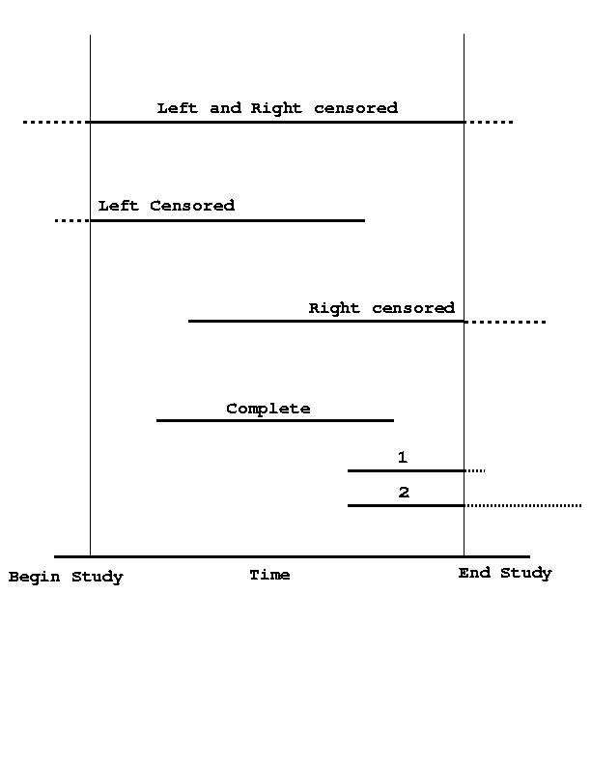
Censored time intervals
Notes:
Exl: survival time after cancer treatment : often expressed as %survival to 5 years after.

Slide 54
Censoring/Truncation (cont.)
If censoring/truncation mechanism not known, analysis can be inaccurate and biased.
But if you know the mechanism, you can mitigate the bias from the analysis.
Metadata should record the existence as well as the nature of censoring/truncation

Slide 55
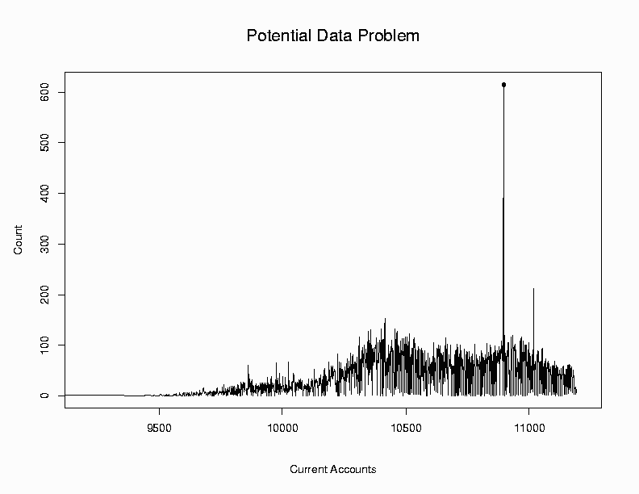
Spikes usually indicate censored time intervals
caused by resetting of timestamps to defaults
Notes:
A subset of the data was censored.

Slide 56
Suspicious Data
Consider the data points
3, 4, 7, 4, 8, 3, 9, 5, 7, 6, 92
“92” is suspicious - an outlier
Outliers are potentially legitimate
Often, they are data or model glitches
Or, they could be a data miner’s dream, e.g. highly profitable customers

Slide 57
Outliers
Outlier – “departure from the expected”
Types of outliers – defining “expected”
Many approaches
  Error bounds, tolerance limits – control charts
  Model based – regression depth, analysis of residuals
  Geometric
  Distributional
  Time Series outliers

Slide 58
Control Charts
Quality control of production lots
Typically univariate: X-Bar, R, CUSUM
Distributional assumptions for charts not based on means e.g. R–charts
Main steps (based on statistical inference)
  Define “expected” and “departure” e.g. Mean and standard error based on sampling distribution of sample mean (aggregate);
  Compute aggregate each sample
  Plot aggregates vs expected and error bounds
  “Out of Control” if aggregates fall outside bounds

Slide 59
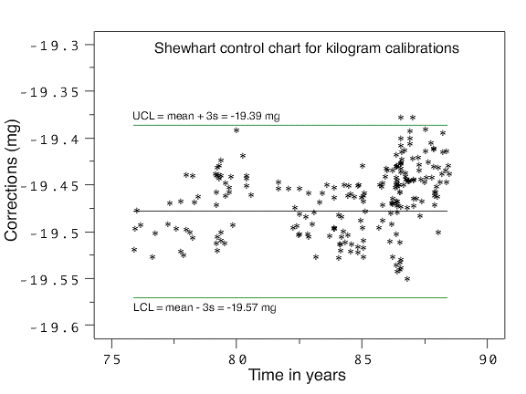
An Example
(http://www.itl.nist.gov/div898/handbook/mpc/section3/mpc3521.htm)
Notes:
Mentioned Sunday by John Bates (NOAA) at the mpds workshop.

Slide 60
Multivariate Control Charts - 1
Bivariate charts:
  based on bivariate Normal assumptions
  component-wise limits lead to Type I, II errors
Depth based control charts (nonparametric):
  map n-dimensional data to one dimension using depth e.g. Mahalanobis
  Build control charts for depth
  Compare against benchmark using depth e.g. Q-Q plots of depth of each data set
Notes:
Depth : multivariate way of ordering data.
Q-Q chart : assume “good” data set. Is the depth curve as you expect (i.e. straight line).

Slide 61
Bivariate Control Chart
Y
X

Slide 62
Multivariate Control Charts - 2
Multiscale process control with wavelets:
  Detects abnormalities at multiple scales as large wavelet coefficients.
  Useful for data with heteroscedasticity
  Applied in chemical process control

Slide 63
Model Fitting and Outliers
Models summarize general trends in data
  more complex than simple aggregates
  e.g. linear regression, logistic regression focus on attribute relationships
Data points that do not conform to well fitting models are potential outliers
Goodness of fit tests (DQ for analysis/mining)
  check suitableness of model to data
  verify validity of assumptions
  data rich enough to answer analysis/business question?
Notes:
Do two things.
Assume a model to find outliers.
GOF : But does the model really fit?

Slide 64
Set Comparison and Outlier Detection
“Model” consists of partition based summaries
Perform nonparametric statistical tests for a rapid section-wise comparison of two or more massive data sets
If there exists a baseline “good’’ data set, this technique can detect potentially corrupt sections in the test data set

Slide 65
Goodness of Fit - 1
Chi-square test
  Are the attributes independent?
  Does the observed (discrete) distribution match the assumed distribution?
Tests for Normality
Q-Q plots (visual)
Kolmogorov-Smirnov test
Kullback-Liebler divergence
Notes:
KS test : measure distance between two CDFs (max distance)
KL test : mutual entropy of CDFs. Biased towards tails.

Slide 66
Goodness of Fit - 2
Analysis of residuals
  Departure of individual points from model
  Patterns in residuals reveal inadequacies of model or violations of assumptions
  Reveals bias (data are non-linear) and peculiarities in data (variance of one attribute is a function of other attributes)
  Residual plots

Slide 67
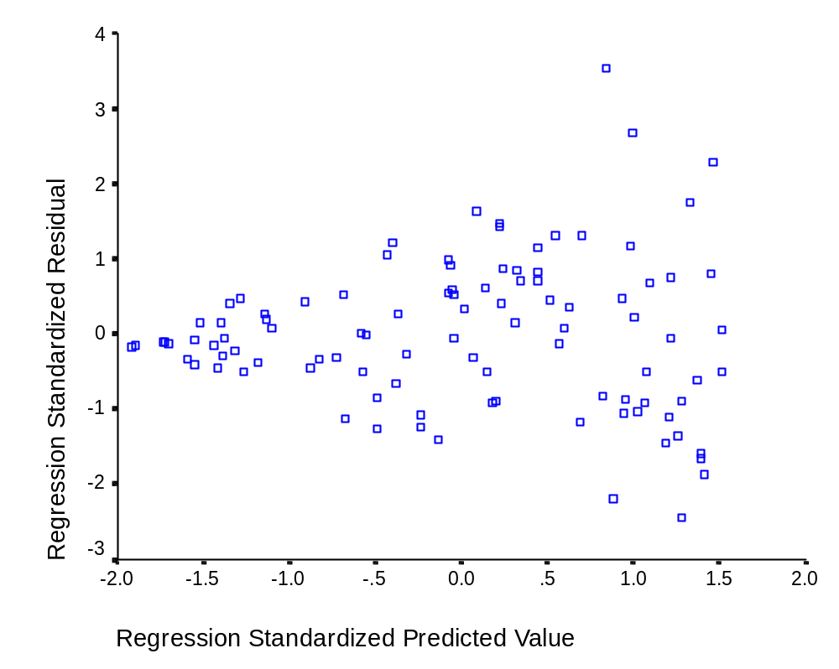
Detecting heteroscedasticity
http://www.socstats.soton.ac.uk/courses/st207307/lecture_slides/l4.doc
Notes:
Issue : you can’t trust outlier results because of heterscedasticity.
You need to modify the model.

Slide 68
Goodness of Fit -3
Regression depth
  measures the “outlyingness” of a model, not an individual data point
  indicates how well a regression plane represents the data
  If a regression plane needs to pass through many points to rotate to the vertical (non-fit) position, it has high regression depth
Notes:
Regression plane via depth is robust version of linear regression

Slide 69
Geometric Outliers
Define outliers as those points at the periphery of the data set.
Peeling : define layers of increasing depth, outer layers contain the outlying points
  Convex Hull: peel off successive convex hull points.
  Depth Contours: layers are the data depth layers.
Efficient algorithms for 2-D, 3-D.
Computational complexity increases rapidly with dimension.
  Ω(N^{ceil(d/2)}) complexity for N points, d dimensions

Slide 70
Distributional Outliers
For each point, compute the maximum distance to its k nearest neighbors.
  DB(p,D)-outlier : at least fraction p of the points in the database lie at distance greater than D.
Fast algorithms
  One is O(dN²), one is O(c^{d}+N)
Local Outliers : adjust definition of outlier based on density of nearest data clusters.

Slide 71
Time Series Outliers
Data is a time series of measurements of a large collection of entities (e.g. customer usage).
Vector of measurements define a trajectory for an entity.
A trajectory can be glitched, and it can make make radical but valid changes.
Approach: develop models based on entity’s past behavior (within) and all entity behavior (relative).
Find potential glitches:
  Common glitch trajectories
  Deviations from within and relative behavior.
Notes:
Similar to signature approaches for fraud detection.

Slide 72
Database Tools
Most DBMS’s provide many data consistency tools
  Transactions
  Data types
  Domains (restricted set of field values)
  Constraints
    Column Constraints
      Not Null, Unique, Restriction of values
    Table constraints
      Primary and foreign key constraints
  Powerful query language
  Triggers
  Timestamps, temporal DBMS

Slide 73
Then why is every DB dirty?
Consistency constraints are often not used
  Cost of enforcing the constraint
    E.g., foreign key constraints, triggers.
  Loss of flexibility
  Constraints not understood
    E.g., large, complex databases with rapidly changing requirements
  DBA does not know / does not care.
Garbage in
  Merged, federated, web-scraped DBs.
Undetectable problems
  Incorrect values, missing data
Metadata not maintained
Database is too complex to understand

Slide 74
Too complex to understand …
Recall Lecture 2 : ER diagrams
  Modeling even toy problems gets complicated
Unintended consequences
  Best example: cascading deletes to enforce participation constraints
    Consider salesforce table and sales table. Participation constraint of salesforce in sales. Then you fire a salesman …
Real life is complicated. Hard to anticipate special situations
  Textbook example of functional dependencies: zip code determines state. Except for a few zip codes in sparsely populated regions that straddle states.

Slide 75
Tools
Extraction, Transformation, Loading
Approximate joins
Duplicate finding
Database exploration

Slide 76
Data Loading
Extraction, Transformation, Loading (ETL)
The data might be derived from a questionable source.
  Federated database, Merged databases
  Text files, log records
  Web scraping
The source database might admit a limited set of queries
The data might need restructuring
  Field value transformation
  Transform tables (e.g. denormalize, pivot, fold)

Slide 77
(example of pivot)
unpivot
pivot
Customer Part Sales
Bob bolt 32
Bob nail 112
Bob rivet 44
Sue glue 12
Sue nail 8
Pete bolt 421
Pete glue 6
Customer bolt nail rivet glue
Bob 32 112 44 0
Sue 0 8 0 12
Pete 421 0 0 6

Slide 78
ETL
Provides tools to
  Access data (DB drivers, web page fetch, parse tools)
  Validate data (ensure constraints)
  Transform data (e.g. addresses, phone numbers)
  Load data
Design automation
  Schema mapping
  Queries to data sets with limited query interfaces (web queries)

Slide 79
(Example of schema mapping [MHH00])
Address
ID Addr
Mapping 1
Personnel
Professor
Name Sal
ID Name Sal
Student
Name GPA Yr
PayRate
Rank HrRate
Mapping 2
WorksOn
Name Proj Hrs ProjRank

Slide 80
Web Scraping
Lots of data in the web, but its mixed up with a lot of junk.
Problems:
  Limited query interfaces
    Fill in forms
  “Free text” fields
    E.g. addresses
  Inconsistent output
    I.e., html tags which mark interesting fields might be different on different pages.
  Rapid change without notice.

Slide 81
Tools
Automated generation of web scrapers
  Excel will load html tables
Automatic translation of queries
  Given a description of allowable queries on a particular source
Monitor results to detect quality deterioration
Extraction of data from free-form text
  E.g. addresses, names, phone numbers
  Auto-detect field domain

Slide 82
Approximate Matching
Relate tuples whose fields are “close”
  Approximate string matching
    Generally, based on edit distance.
    Fast SQL expression using a q-gram index
  Approximate tree matching
    For XML
    Much more expensive than string matching
    Recent research in fast approximations
  Feature vector matching
    Similarity search
    Many techniques discussed in the data mining literature.
  Ad-hoc matching
    Look for a clever trick.

Slide 83
Approximate Joins and Duplicate Elimination
Perform joins based on incomplete or corrupted information.
  Approximate join : between two different tables
  Duplicate elimination : within the same table
More general than approximate matching.
  Semantics : Need to use special transforms and scoring functions.
  Correlating information : verification from other sources, e.g. usage correlates with billing.
  Missing data : Need to use several orthogonal search and scoring criteria.
But approximate matching is a valuable tool …

Slide 84
Algorithm
Partition data set
  By hash on computed key
  By sort order on computed key
  By similarity search / approximate match on computed key
Perform scoring within the partition
  Hash : all pairs
  Sort order, similarity search : target record to retrieved records
Record pairs with high scores are matches
Use multiple computed keys / hash functions
Duplicate elimination : duplicate records form an equivalence class.

Slide 85
(Approximate Join Example)
Sales
“Gen” bucket
Provisioning
Sales
Provisioning
Genrl. Eclectic
General Magic
Gensys
Genomic Research
Genrl. Electric
Genomic Research
Gensys Inc.
Match
Genrl. Eclectic
Genomic Research
Gensys
Genrl. Electric
Genomic Research
Gensys Inc.

Slide 86
Database Exploration
Tools for finding problems in a database
  Opposite of ETL
  Similar to data quality mining
Simple queries are effective:
Select Field, count(*) as Cnt
from Table
Group by Field
Order by Cnt Desc
  Hidden NULL values at the head of the list, typos at the end of the list
Just look at a sample of the data in the table.

Slide 87
Database Profiling
Systematically collect summaries of the data in the database
  Number of rows in each table
  Number of unique, null values of each field
  Skewness of distribution of field values
  Data type, length of the field
    Use free-text field extraction to guess field types (address, name, zip code, etc.)
  Functional dependencies, keys
  Join paths
Does the database contain what you think it contains?
  Usually not.

Slide 88
Finding Keys and Functional Dependencies
Key: set of fields whose value is unique in every row
Functional Dependency: A set of fields which determine the value of another field
  E.g., ZipCode determines the value of State
    But not really …
Problems: keys not identified, uniqueness not enforced, hidden keys and functional dependencies.
Key finding is expensive: O(f^{k}) Count Distinct queries to find all keys of up to k fields.
Fortunately, we can prune a lot of this search space if we search only for minimal keys and FDs
Approximate keys : almost but not quite unique.
Approximate FD : similar idea

Slide 89
Effective Algorithm
Eliminate “bad” fields
  Float data type, mostly NULL, etc.
Collect an in-memory sample
  Perhaps storing a hash of the field value
Compute count distinct on the sample
  High count : verify by count distinct on database table.
Use Tane style level-wise pruning
Stop after examining 3-way or 4-way keys
  False keys with enough attributes.

Slide 90
Finding Join Paths
How do I correlate this information?
In large databases, hundreds of tables, thousands of fields.
Our experience: field names are very unreliable.
  Natural join does not exist outside the laboratory.
Use data types and field characterization to narrow the search space.

Slide 91
Min Hash Sampling
Special type of sampling which can estimate the resemblance of two sets
  Size of intersection / size of union
Apply to set of values in a field, store the min hash sample in a database
  Use an SQL query to find all fields with high resemblance to a given field
  Small sample sizes suffice.
Problem: fields which join after a small data transformation
  E.g “SS123-45-6789” vs. “123-45-6789”
Solution: collect min hash samples on the qgrams of a field
  Alternative: collect sketches of qgram frequency vectors

Slide 92
Domain Expertise
Data quality gurus: “We found these peculiar records in your database after running sophisticated algorithms!”
Domain Experts: “Oh, those apples - we put them in the same baskets as oranges because there are too few apples to bother. Not a big deal. We knew that already.”

Slide 93
Why Domain Expertise?
DE is important for understanding the data, the problem and interpreting the results
    “The counter resets to 0 if the number of calls exceeds N”.
    “The missing values are represented by 0, but the default billed amount is 0 too.”
Insufficient DE is a primary cause of poor DQ – data are unusable
DE should be documented as metadata

Slide 94
Where is the Domain Expertise?
Usually in people’s heads – seldom documented
Fragmented across organizations
  Often experts don’t agree. Force consensus.
Lost during personnel and project transitions
If undocumented, deteriorates and becomes fuzzy over time

Slide 95
Metadata
Data about the data
Data types, domains, and constraints help, but are often not enough
Interpretation of values
  Scale, units of measurement, meaning of labels
Interpretation of tables
  Frequency of refresh, associations, view definitions
Most work done for scientific databases
  Metadata can include programs for interpreting the data set.

Slide 96
XML
Data interchange format, based on SGML
Tree structured
  Multiple field values, complex structure, etc.
“Self-describing” : schema is part of the record
  Field attributes
DTD : minimal schema in an XML record.
<tutorial>
<title> Data Quality and Data Cleaning: An Overview <\title>
<Conference area=“database”> SIGMOD <\Conference>
<author> T. Dasu
<bio> Statistician <\bio> <\author>
<author> T. Johnson
<institution> AT&T Labs <\institution> <\author>
<\tutorial>

Slide 97
What’s Missing?
Most metadata relates to static properties
  Database schema
  Field interpretation
Data use and interpretation requires dynamic properties as well
  What is the business process?
  80-20 rule

Slide 98
Lineage Tracing
Record the processing used to create data
  Coarse grained: record processing of a table
  Fine grained: record processing of a record
Record graph of data transformation steps.
Used for analysis, debugging, feedback loops

Slide 99
Case Study

Slide 100
Case Study
Provisioning inventory database
  Identify equipment needed to satisfy customer order.
    False positives : provisioning delay
    False negatives : decline the order, purchase unnecessary equipment
The initiative
  Validate the corporate inventory
  Build a database of record.
  Has top management support.

Slide 101
Task Description
OPED : operations database
  Components available in each local warehouse
IOWA : information warehouse
  Machine descriptions, owner descriptions
SAPDB : Sales and provisioning database
  Used by sales force when dealing with clients.
Data flow
OPED → IOWA → SAPDB

Slide 102
Data Audits
Analyze databases and data flow to verify metadata / find problems
  Documented metadata was insufficient
    OPED.warehouseid is corrupted, workaround process used
    70 machine types in OPED, only 10 defined.
    SAPDB contains only 15% of the records in OPED or IOWA
  “Satellite” databases at local sites not integrated with main databases
  Numerous workaround processes.

Slide 103
Data Improvements
Satellite databases integrated into main databases.
Address mismatches cleaned up.
  And so was the process which caused the mismatches
Static and dynamic data constraints defined.
  Automated auditing process
  Regular checks and cleanups

Slide 104
What did we learn?
Take nothing for granted
  Metadata is always wrong, every bad thing happens.
Manual entry and intervention causes problems
  Automate processes.
  Remove the need for manual intervention.
    Make the regular process reflect practice.
Defining data quality metrics is key
  Defines and measures the problem.
  Creates metadata.
Organization-wide data quality
  Data steward for the end-to-end process.
  Data publishing to establish feedback loops.

Slide 105
Research Directions

Slide 106
Challenges in Data Quality
Multifaceted nature
  Problems are introduced at all stages of the process.
    but especially at organization boundaries.
  Many types of data and applications.
Highly complex and context-dependent
  The processes and entities are complex.
  Many problems in many forms.
No silver bullet
  Need an array of tools.
  And the discipline to use them.

Slide 107
Data Quality Research
Burning issues
  Data quality mining
  Advanced browsing / exploratory data mining
  Reducing complexity
  Data quality metrics

Slide 108
“Interesting” Data Quality Research
Recent research that I think is interesting and important for an aspect of data quality.
CAVEAT
  This list is meant to be an example, it is not exhaustive.
  It contains research that I’ve read recently.
  I’m not listing many interesting papers, including yours.

Slide 109
Bellman
T. Dasu, T. Johnson, S. Muthukrishnan, V. Shkapenyuk, Mining database structure; or, how to build a data quality browser, SIGMOD 2002 pg 240-251
“Data quality” browser.
Perform profiling on the database
  Counts, keys, join paths, substring associations
Use to explore large databases.
  Extract missing metadata.

Slide 110
DBXplorer
S. Agrawal, S. Chaudhuri, G. Das, DBXplorer: A System for Keyword-Based Search over Relational Databases, ICDE 2002.
Keyword search in a relational database, independent of the schema.
Pre-processing to build inverted list indices (profiling).
Build join queries for multiple keyword search.

Slide 111
Potters Wheel
V. Raman, J.M. Hellerstein, Potter's Wheel: An Interactive Data Cleaning System, VLDB 2001 pg. 381-390
ETL tool, especially for web scraped data.
Two interesting features:
  Scalable spreadsheet : interactive view of the results of applying a data transformation.
  Field domain determination
    Apply domain patterns to fields, see which ones fit best.
    Report exceptions.

Slide 112
OLAP Exploration
S. Sarawagi, G. Sathe, i³: Intelligent, Interactive Investigation of OLAP data cubes, SIGMOD 2000 pg. 589
Suite of tools (operators) to automate the browsing of a data cube.
  Find “interesting” regions

Slide 113
Contaminated Data
Data Quality Mining
Pearson, R. (2001) “Data Mining in the Face of Contaminated and Incomplete Records”, tutorial at SDM 2002
Outliers in process modeling and identification
Pearson, R.K.; Control Systems Technology, IEEE Transactions on , Volume: 10 Issue: 1 , Jan 2002
Page(s): 55 -63
Methods
  identifying outliers (Hampel limits),
  missing value imputation,
  compare results of fixed analysis on similar data subsets
  others

Slide 114
Data Quality Mining : Deviants
H.V. Jagadish, N. Koudas, S. Muthukrishnan, Mining Deviants in a Time Series Database, VLDB 1999 102-112.
Deviants : points in a time series which, when removed, yield best accuracy improvement in a histogram.
Use deviants to find glitches in time series data.

Slide 115
Data Quality Mining
F. Korn, S. Muthukrishnan, Y. Zhu, Monitoring Data Quality Problems in Network Databases, VLDB 2003
Define probably approximately correct constraints for a data feed (network performance data)
  Range, smoothness, balance, functional dependence, unique keys
Automation of constraint selection and threshold setting
Raise alarm when constraints fail above tolerable level.

Slide 116
Data Quality Mining: Depth Contours
S. Krishnan, N. Mustafa, S. Venkatasubramanian, Hardware-Assisted Computation of Depth Contours. SODA 2002 558-567.
Parallel computation of depth contours using graphics card hardware.
  Cheap parallel processor
  Depth contours :
    Multidimensional analog of the median
    Used for nonparametric statistics

Slide 117

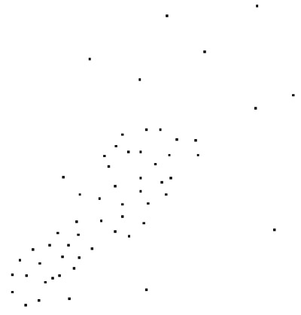
Points
Depth Contours

Slide 118
Approximate Matching
L. Gravano, P.G. Ipeirotis, N. Koudas, D. Srivastava, Text Joins in a RDBMS for Web Data Integration, WWW2003
Approximate string matching using IR techniques
  Weight edit distance by inverse frequency of differing tokens (words or q-grams)
    If “Corp.” appears often, its presence or absence carries little weight. “IBM Corp.” close to “IBM”, far from “AT&T Corp.”
Define an SQL-queryable index

Slide 119
Exploratory Data Mining
J.D. Becher, P. Berkhin, E. Freeman, Automating Exploratory Data Analysis for Efficient Data Mining, KDD 2000
Use data mining and analysis tools to determine appropriate data models.
In this paper, attribute selection for classification.

Slide 120
Exploratory Data Mining
R.T. Ng, L.V.S. Lakshmanan, J. Han, A. Pang, Exploratory Mining and Pruning Optimizations of Constrained Association Rules, SIGMOD 1998 pg 13-24
Interactive exploration of data mining (association rule) results through constraint specification.

Slide 121
Exploratory Schema Mapping
M.A. Hernandez, R.J. Miller, L.M. Haas, Clio: A Semi-Automatic Tool for Schema Mapping, SIGMOD 2001
Automatic generation and ranking of schema mapping queries
Tool for suggesting field mappings
Interactive display of alternate query results.

Slide 122
Conclusions
Now that processing is cheap and access is easy, the big problem is data quality.
Considerable research, but highly fragmented
Lots of opportunities for applied research, once you understand the problem domain.
Any questions?

Slide 123
Bibliography
Note: these references are an
introductory sample of the
literature.

Slide 124
References
Process Management
  http://web.mit.edu/tdqm/www/about.html
Missing Value Imputation
  Schafer, J. L. (1997), Analysis of Incomplete Multivariate Data, New York: Chapman and Hall
  Little, R. J. A. and D. B. Rubin. 1987. "Statistical Analysis with Missing Data." New York: John Wiley & Sons.
  Release 8.2 of SAS/STAT - PROCs MI, MIANALYZE
  “Learning from incomplete data”. Z. Ghahramani and M. I. Jordan. AI Memo 1509, CBCL Paper 108, January 1995, 11 pages.

Slide 125
References
Censoring / Truncation
  Survival Analysis: Techniques for Censored and Truncated Data”. John P. Klein and Melvin L. Moeschberger
  "Empirical Processes With Applications to Statistics”. Galen R. Shorack and Jon A. Wellner; Wiley, New York; 1986.
Control Charts
  A.J. Duncan, Quality Control and Industrial Statistics. Richard D. Irwin, Inc., Ill, 1974.
  Liu, R. Y. and Singh, K. (1993). A quality index based on data depth and multivariate rank tests. J. Amer. Statist. Assoc. 88 252-260. 13
  Aradhye, H. B., B. R. Bakshi, R. A. Strauss,and J. F. Davis (2001). Multiscale Statistical Process Control Using Wavelets - Theoretical Analysis and Properties. Technical Report, Ohio State University

Slide 126
References
Set comparison
  Theodore Johnson, Tamraparni Dasu: Comparing Massive High-Dimensional Data Sets. KDD 1998: 229-233
  Venkatesh Ganti, Johannes Gehrke, Raghu Ramakrishnan: A Framework for Measuring Changes in Data Characteristics. PODS 1999, 126-137
Goodness of fit
  Computing location depth and regression depth in higher dimensions. Statistics and Computing 8:193-203. Rousseeuw P.J. and Struyf A. 1998.
  Belsley, D.A., Kuh, E., and Welsch, R.E. (1980), Regression Diagnostics, New York: John Wiley and Sons, Inc.

Slide 127
References
Geometric Outliers
  Computational Geometry: An Introduction”, Preparata, Shamos, Springer-Verlag 1988
  “Fast Computation of 2-Dimensional Depth Contours”, T. Johnson, I. Kwok, R. Ng, Proc. Conf. Knowledge Discovery and Data Mining pg 224-228 1988
Distributional Outliers
  “Algorithms for Mining Distance-Based Outliers in Large Datasets”, E.M. Knorr, R. Ng, Proc. VLDB Conf. 1998
  “LOF: Identifying Density-Based Local Outliers”, M.M. Breunig, H.-P. Kriegel, R. Ng, J. Sander, Proc. SIGMOD Conf. 2000
Time Series Outliers
  “Hunting data glitches in massive time series data”, T. Dasu, T. Johnson, MIT Workshop on Information Quality 2000.

Slide 128
References
ETL
  “Data Cleaning: Problems and Current Approaches”, E. Rahm, H.H. Do, Data Engineering Bulletin 23(4) 3-13, 2000
  “Declarative Data Cleaning: Language, Model, and Algorithms”, H. Galhardas, D. Florescu, D. Shasha, E. Simon, C.-A. Saita, Proc. VLDB Conf. 2001
  “Schema Mapping as Query Discovery”, R.J. Miller, L.M. Haas, M.A. Hernandez, Proc. 26th VLDB Conf. Pg 77-88 2000
  “Answering Queries Using Views: A Survey”, A. Halevy, VLDB Journal, 2001
  “A Foundation for Multi-dimensional Databases”, M. Gyssens, L.V.S. Lakshmanan, VLDB 1997 pg. 106-115
  “SchemaSQL – An Extension to SQL for Multidatabase Interoperability”, L.V.S. Lakshmanan, F. Sadri, S.N. Subramanian, ACM Transactions on Database Systems 26(4) 476-519 2001
  “Don't Scrap It, Wrap It! A Wrapper Architecture for Legacy Data Sources”, M.T. Roth, P.M. Schwarz, Proc. VLDB Conf. 266-275 1997
  “Declarative Data Cleaning: Language, Model, and Algorithms
  ”, H. Galhardas, D. Florescu, D. Shasha, E. Simon, C. Saita, Proc. VLDB Conf. Pg 371-380 2001

Slide 129
References
Web Scraping
  “Automatically Extracting Structure from Free Text Addresses”, V.R. Borkar, K. Deshmukh, S. Sarawagi, Data Engineering Bulletin 23(4) 27-32, 2000
  “Potters Wheel: An Interactive Data Cleaning System”, V. Raman and J.M. Hellerstein, Proc. VLDB 2001
  “Accurately and Reliably Extracting Data From the Web”, C.A. Knoblock, K. Lerman, S. Minton, I. Muslea, Data Engineering Bulletin 23(4) 33-41, 2000
Approximate String Matching
  “A Guided Tour to Approximate String Matching”, G. Navarro, ACM Computer Surveys 33(1):31-88, 2001
  “Using q-grams in a DBMS for Approximate String Processing”, L. Gravano, P.G. Ipeirotis, H.V. Jagadish, N. Koudas, S. Muthukrishnan, L. Pietarinen, D. Srivastava, Data Engineering Bulletin 24(4):28-37,2001.

Slide 130
References
Other Approximate Matching
  “Approximate XML Joins”, N. Koudas, D. Srivastava, H.V. Jagadish, S. Guha, T. Yu, SIGMOD 2002
  “Searching Multimedia Databases by Content”, C. Faloutsos, Klewer, 1996.
Approximate Joins and Duplicate Detection
  “The Merge/Purge Problem for Large Databases”, M. Hernandez, S. Stolfo, Proc. SIGMOD Conf pg 127-135 1995
  “Real-World Data is Dirty: Data Cleansing and the Merge/Purge Problem”, M. Hernandez, S. Stolfo, Data Mining and Knowledge Discovery 2(1)9-37, 1998
  “Telcordia’s Database Reconciliation and Data Quality Analysis Tool”, F. Caruso, M. Cochinwala, U. Ganapathy, G. Lalk, P. Missier, Proc. VLDB Conf. Pg 615-618 2000
  “Hardening Soft Information Sources”, W.W. Cohen, H. Kautz, D. McAllester, Proc. KDD Conf., 255-259 2000

Slide 131
References
Data Profiling
  “Data Profiling and Mapping, The Essential First Step in Data Migration and Integration Projects”, Evoke Software, http://www.evokesoftware.com/pdf/wtpprDPM.pdf
  “TANE: An Efficient Algorithm for Discovering Functional and Approximate Dependencies”, Y. Huhtala, J. K., P. Porkka, H. Toivonen, The Computer Journal 42(2): 100-111 (1999)
  “Mining Database Structure; Or, How to Build a Data Quality Browser”, T.Dasu, T. Johnson, S. Muthukrishnan, V. Shkapenyuk, Proc. SIGMOD Conf. 2002
  “Data-Driven Understanding and Refinement of Schema Mappings”, L.-L. Yan, R. Miller, L.M. Haas, R. Fagin, Proc. SIGMOD Conf. 2001

Slide 132
References
Metadata
  “A Metadata Resource to Promote Data Integration”, L. Seligman, A. Rosenthal, IEEE Metadata Workshop, 1996
  “Using Semantic Values to Facilitate Interoperability Among Heterogenous Information Sources”, E. Sciore, M. Siegel, A. Rosenthal, ACM Trans. On Database Systems 19(2) 255-190 1994
  “XML Data: From Research to Standards”, D. Florescu, J. Simeon, VLDB 2000 Tutorial, http://www-db.research.bell-labs.com/user/simeon/vldb2000.ppt
  “XML’s Impact on Databases and Data Sharing”, A. Rosenthal, IEEE Computer 59-67 2000
  “Lineage Tracing for General Data Warehouse Transformations”, Y. Cui, J. Widom, Proc. VLDB Conf. 471-480 2001

